Slide 1
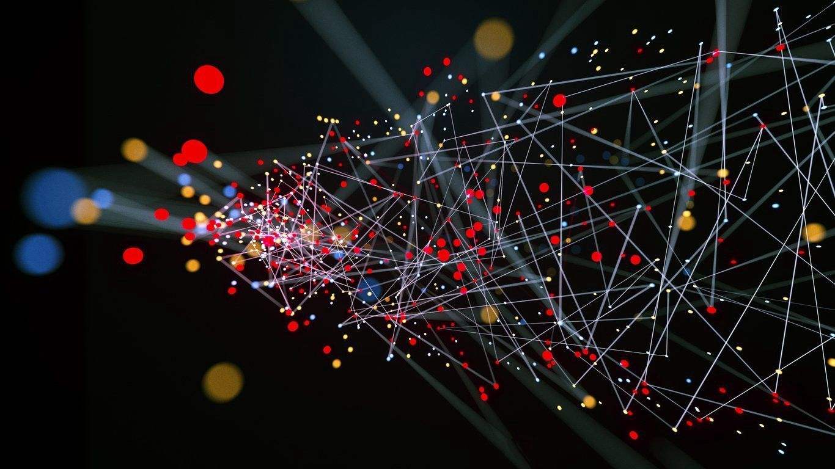
Data Science Lab with R & Python
Final Project
Aadi Shah

Slide 2
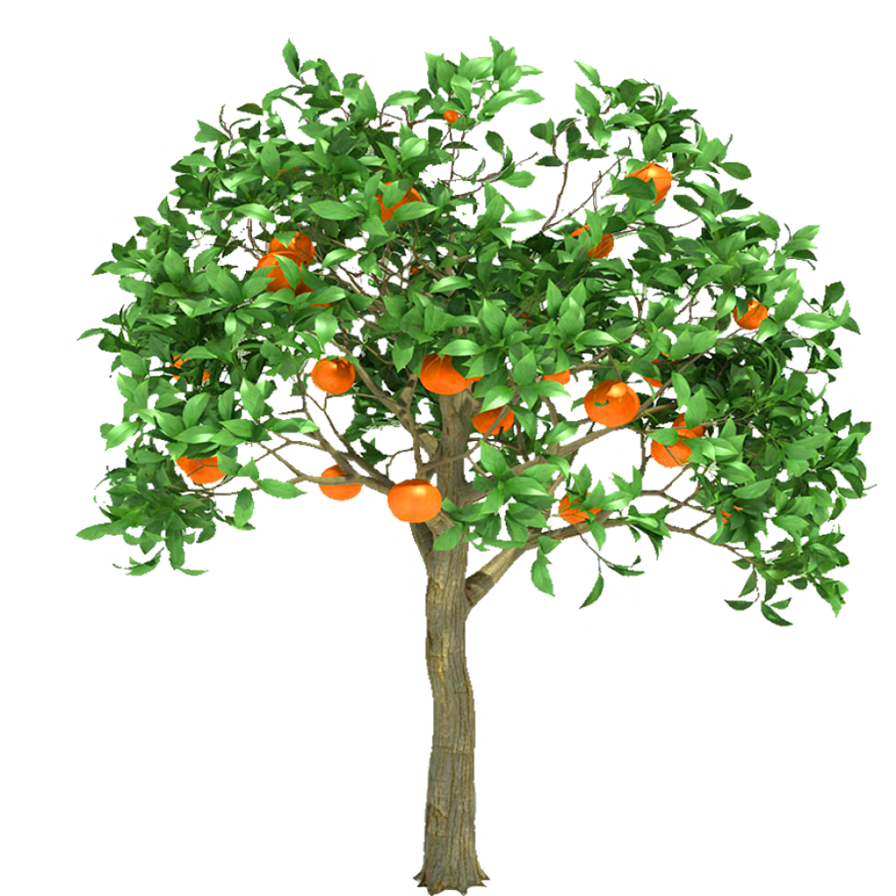
Topic and Motivation
Dataset name: Orange
Correlating age of orange trees and circumference of their trunks
Interested in vegetarian nutrition
Have experience with experiments relating to plant growth
Orange dataset most closely fits

Slide 3
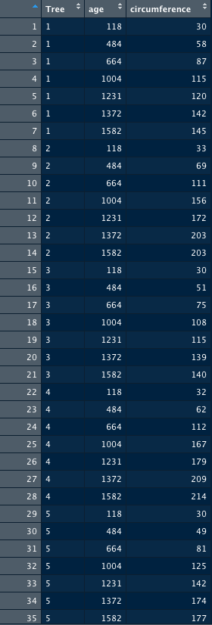
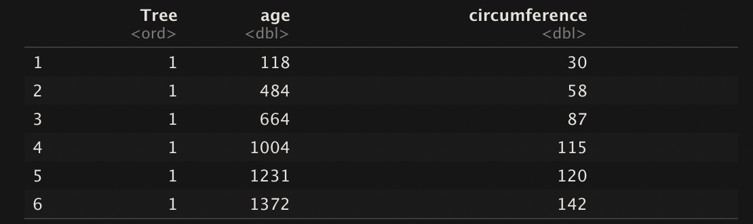
Data
Dataset name: Orange
35 rows, 3 columns
5 trees, data taken from all trees on 7 different days
Independent: Age
Dependent: Circumference

Slide 4
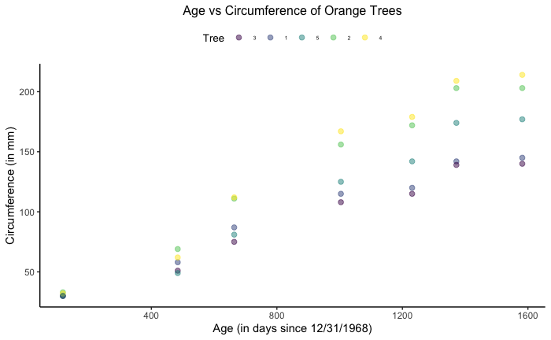
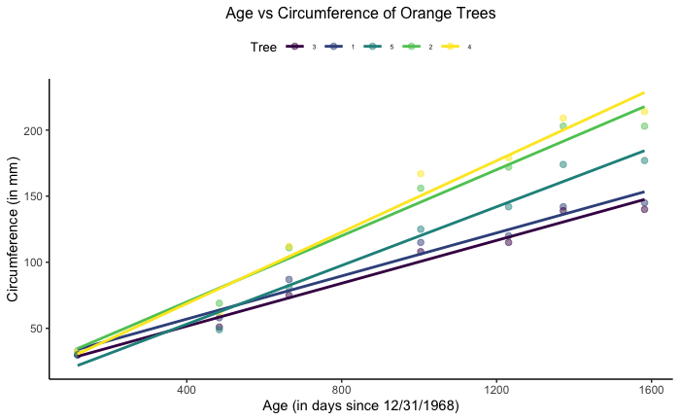
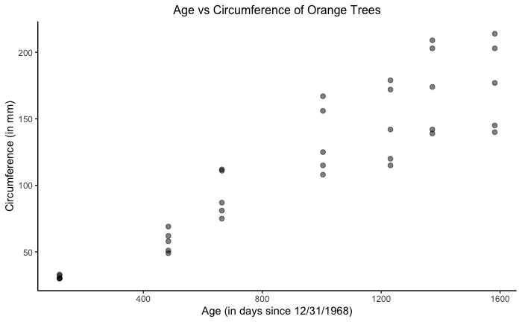
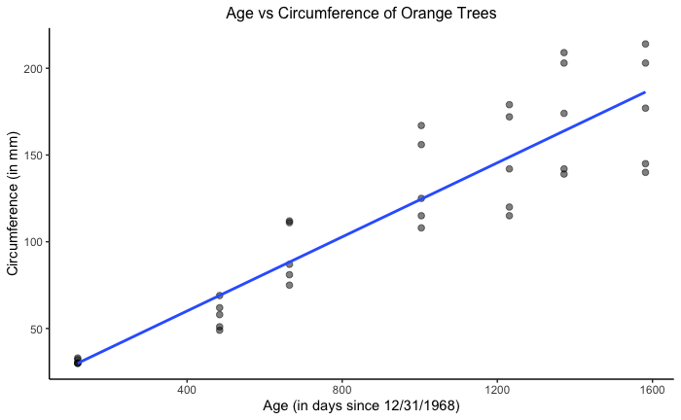
Exploratory Data Analysis
Started with a scatter plot with points for different trees using different colors
Created a multiple linear regression model using different colors
Created a scatter plot using data points from all of the trees
Created a linear regression model using data points from all of the trees
All of the models appear to show a direct correlation between Age and Circumference

Slide 5
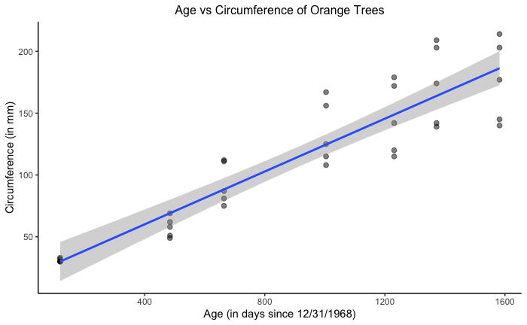
Final Model
95% confidence interval

Slide 6
Interesting Findings
Direct correlation between Age and Circumference
Even if looking at the confidence interval
Required the assumption that growth was constant and linear
No factors that could increase/decrease speed of growth
Protected environment/no human contact
No disease
No death

Slide 7
Conclusions/Future Work
Gain more data if possible
Create models with other regression analysis techniques
Better estimate future plant growth
Research more about which regression analysis techniques are useful for predicting plant growth
Try Logistic Regression

